Slide 1
Value Proposition — Continuous measurement and diagnosis at a curriculum level.

Slide 2
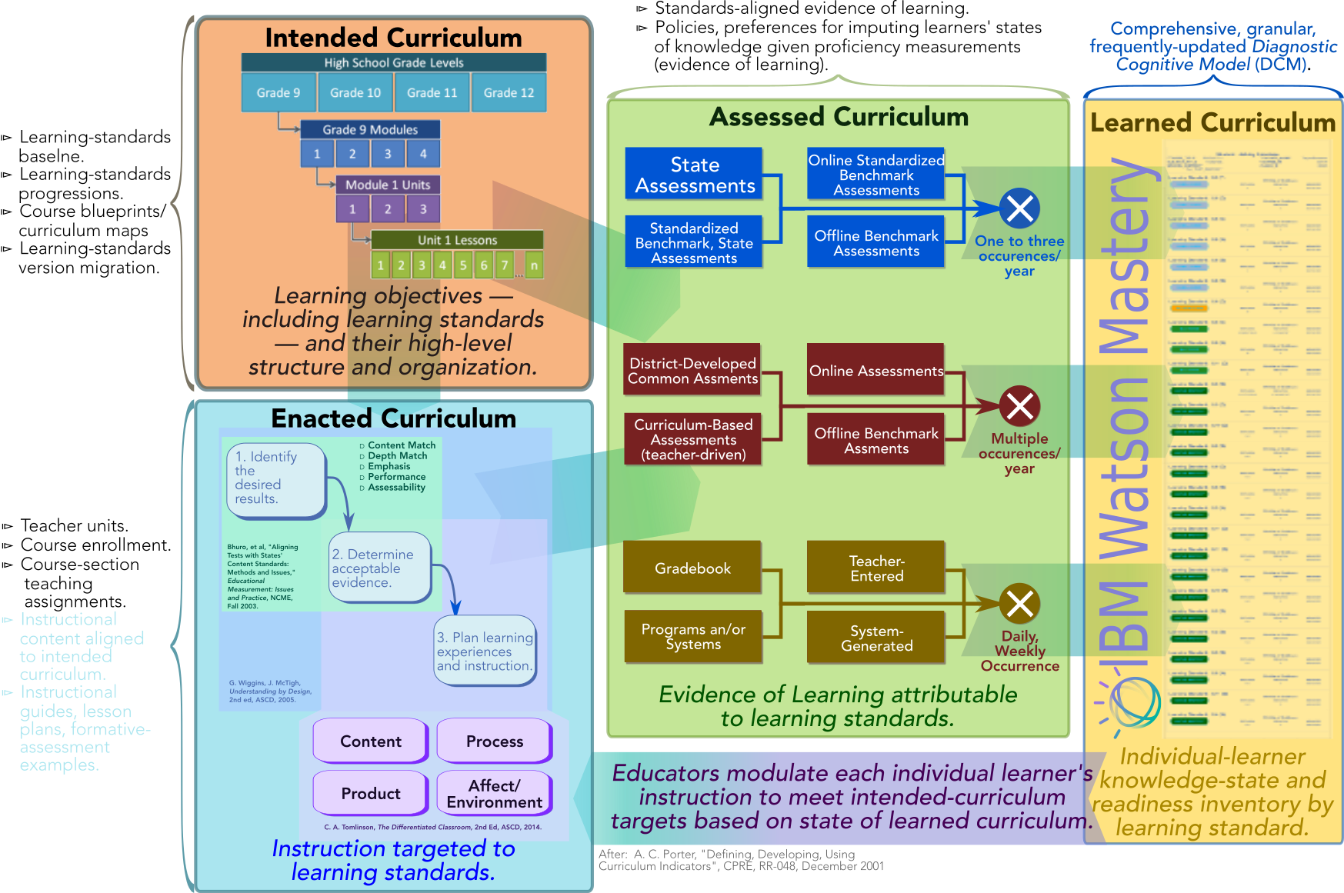
A Well-Aligned Curriculum is one prerequisite to maximizing each student’s Opportunity to Learn (OTL).
A. C. Porter and J. L. Smithson, “Defining, developing, and using curriculum indicators,” Report RR-048, Consortium for Policy Research in Education, University of Pennsylvania, December 2001, http://ibm.biz/PorterCurriculumAlignment.

Slide 3
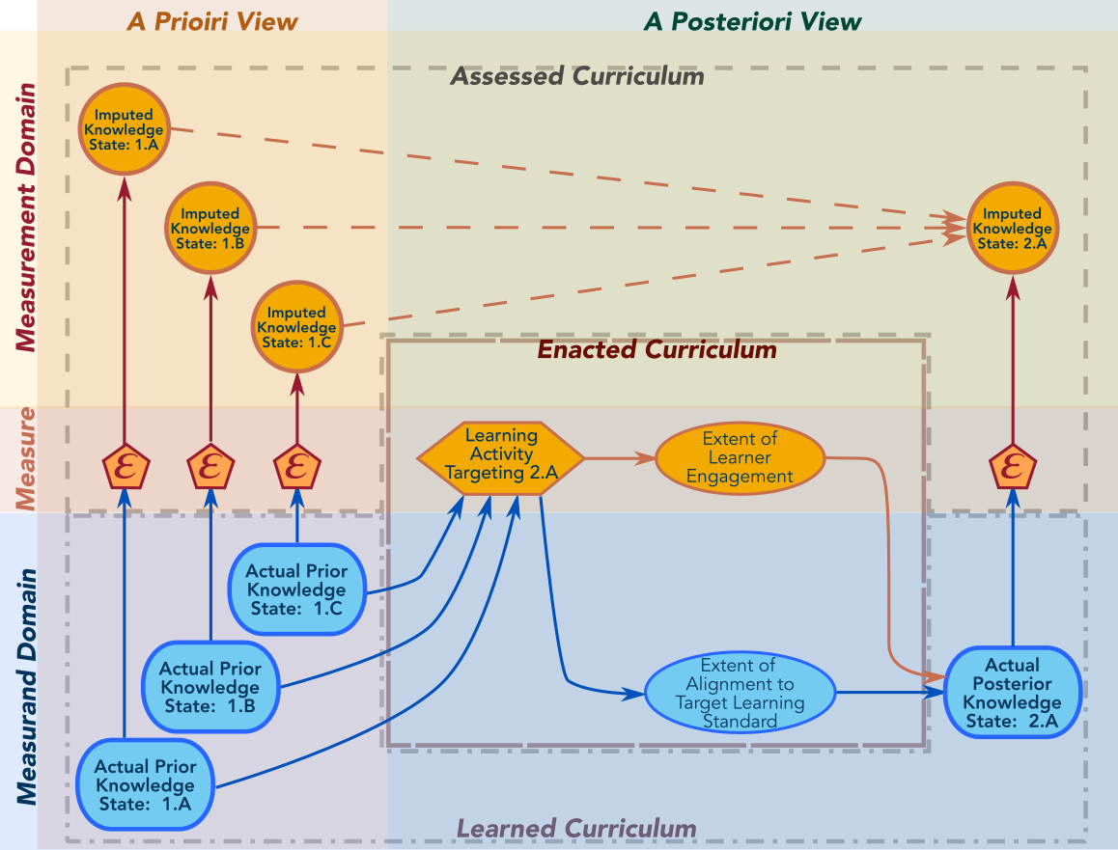
Employing uncertain, imprecise measurements to construct a belief about a not-directly-observable cognitive state represents the central challenge of Diagnostic Cognitive Modeling.

Slide 4
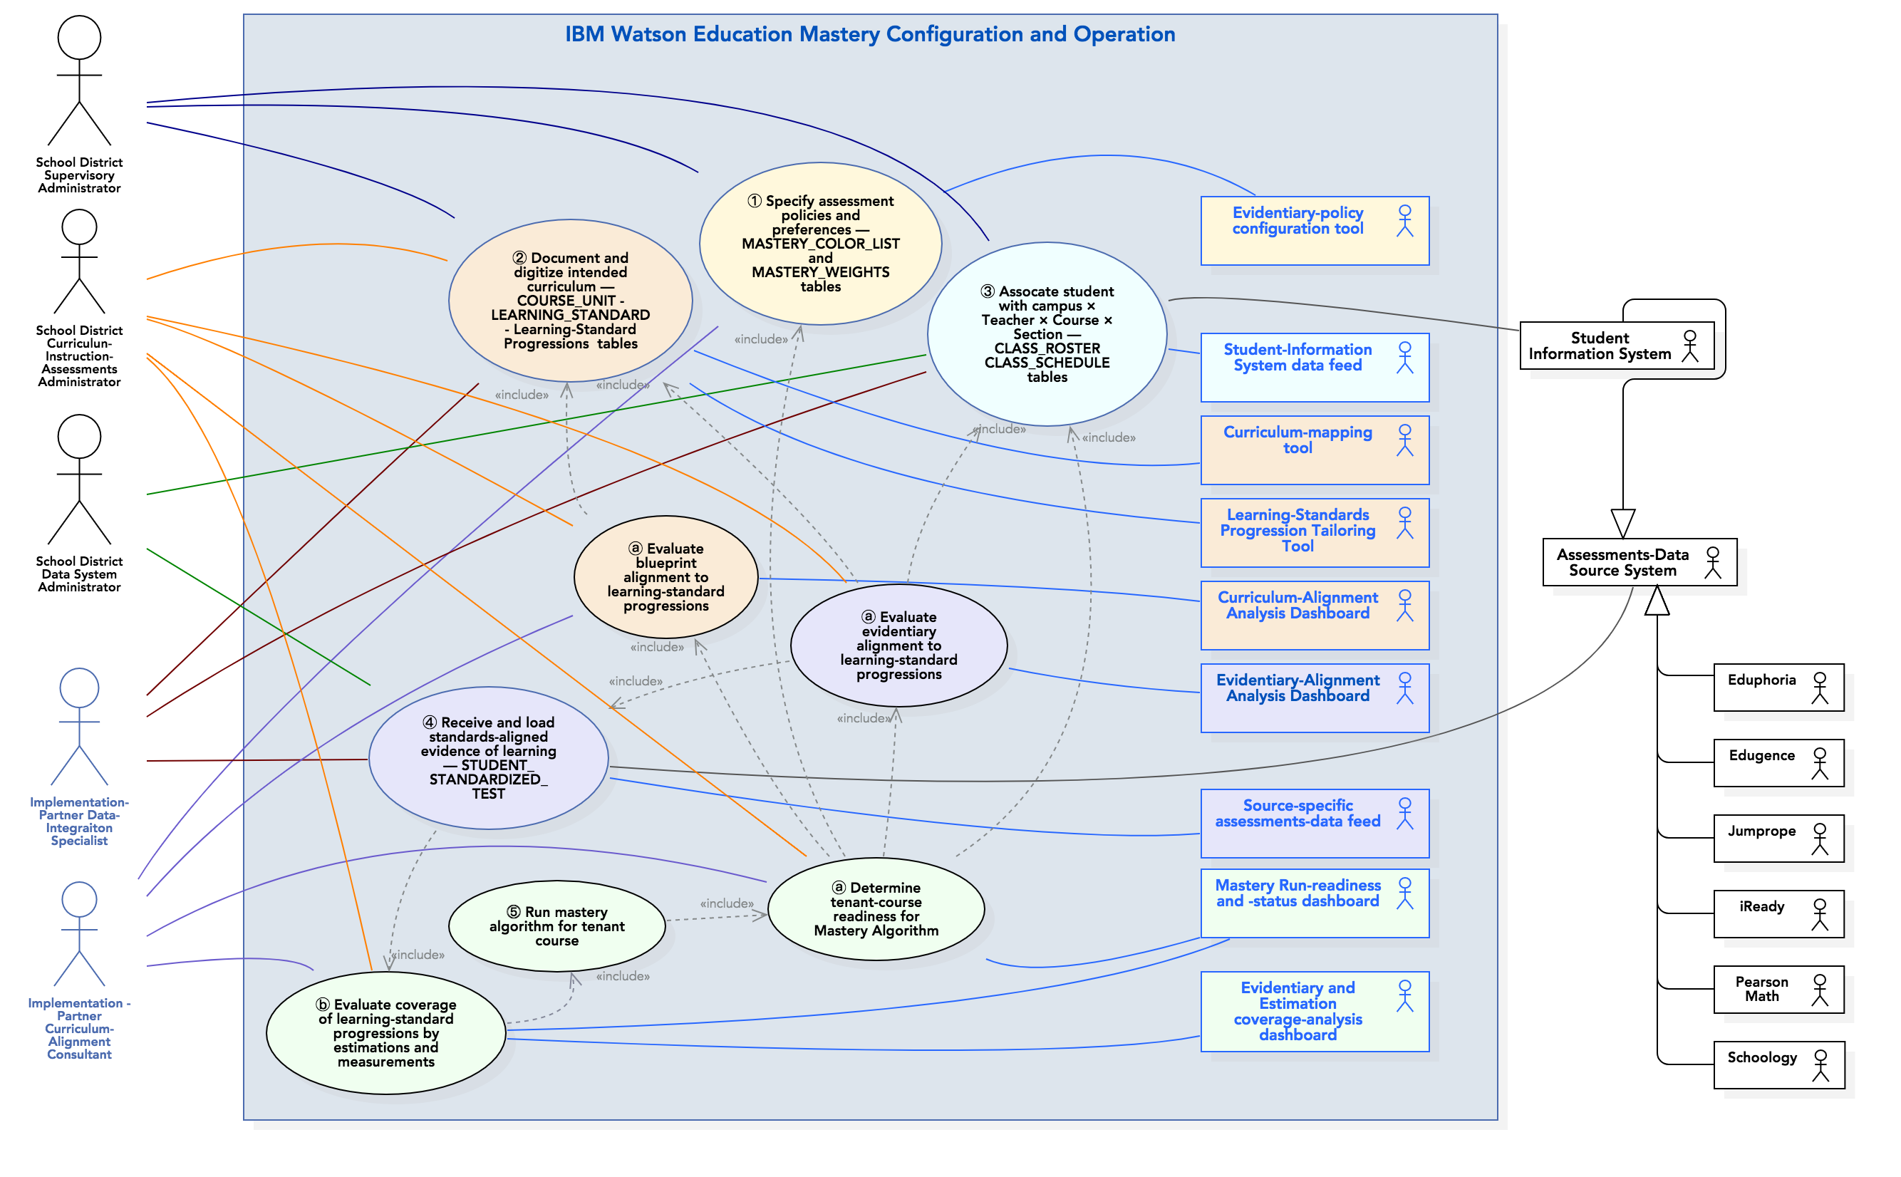
Revise to incorporate run-time SWCIs as system actors.

Slide 5
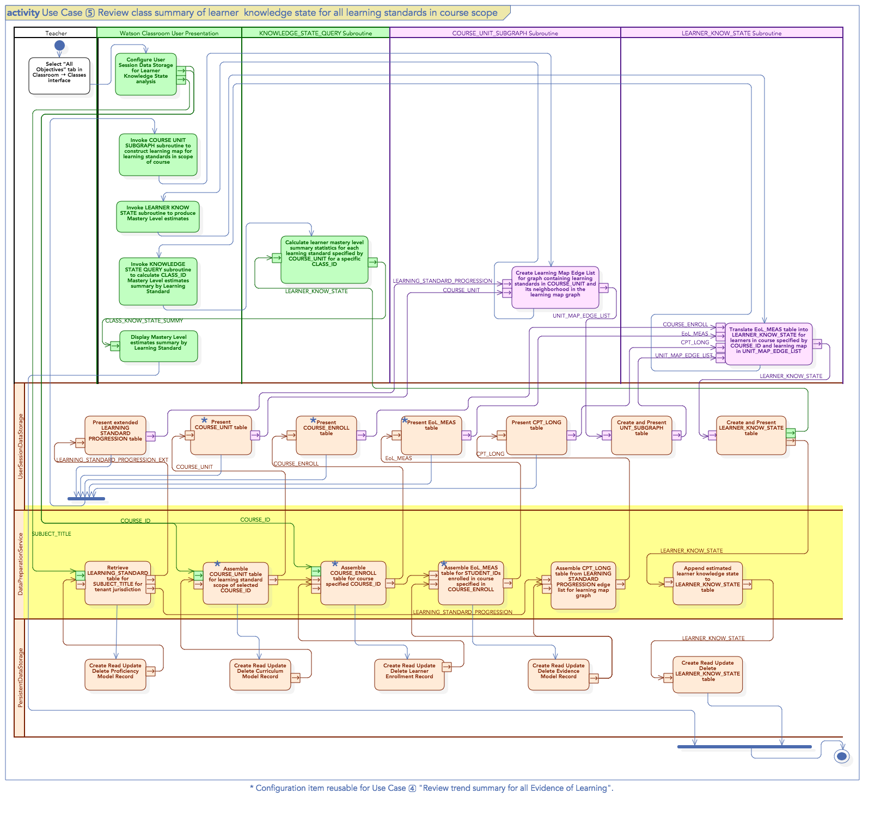
Presen-tation CI.
DCM CI.
DCM-Session Data-Handling CI.
Micro-Service API CI

Slide 6
Configuration-Item Approach
Configure Item | High-Level Functional Summary | Candidate Realization Approaches | Key Decisions, Issues, Risks
Presentation/Output API
Diagnostic Cognitive Model
Session-Data Handling
Micro-Service API

Slide 7
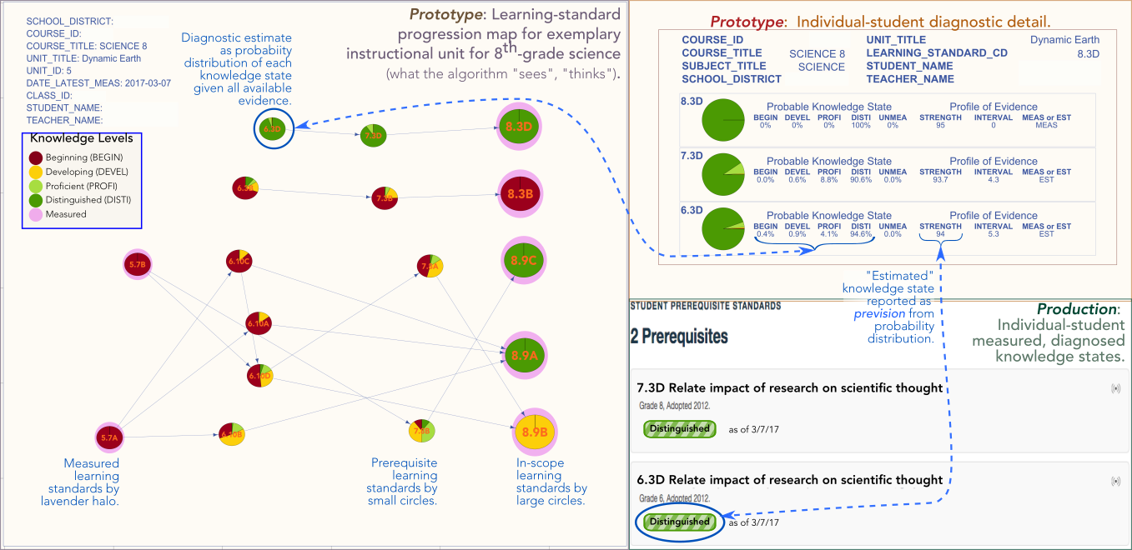
The Mastery DCM algorithm translates the evidentiary state into a belief of a student’s learned state of proficiency 𝒜_{mastery}: ℰ_{𝑠} ↦ 𝒫

Slide 8
DCM Realization
Feature | Approach
Course-graph decomposition
Exact inference
Approximate Inference
“Soft-separation” exact inference v1.0
“Soft-separation” exact inference v2.0
Streams and processes

